Slide 1
Probability and Distribution
AI ToolKit
Fall Semester, 2023
Reference: mml-book.github.io && d2l.ai
Notes:
How can summarize matrices, how matrices can be decomposed.

Slide 2



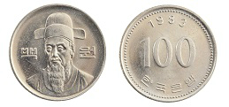
Coin Toss example
How can we “quantify” the likelihood of observing heads?
Assuming the “fair” coin, both outcomes are equally likely.
If we get tails and heads, let .
We “expect” to see and .
But can we say observed frequencies as “probabilities”? isn’t it “statistics”?
Probability : theoretical quantities that underlie the data generation process.
Statistics : empirical quantities computed as functions of the observed data.

Slide 3







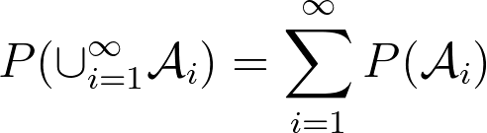
Sample space, event space, and probability.
Sample space : a set of all possible outcomes of the experiment.
i.e., if we toss coins for two times,
= { , , , }
Event : subsets of the sample space.
i.e., the event of “the first coin toss comes up heads” is, ={ , }
Probability function: maps events onto real values, .
The probability of any event is a non-negative real number, .
The probability of the entire sample space is 1, .
For any countable event sequence , if for , ⇒

Slide 4








Random Variables
Mapping from an underlying sample space to a set of values.
For coin-tossing example, assume that you consider “number of heads”.
A random variable maps ( )=2, ( )=1, ( )=1, ( )=0.
Here, if , .
For any subset , .
Remember = { , , , } in this example.
The function is the distribution of random variable .
If is finite or countably infinite (i.e., integer), is discrete random variable.
If , is continuous random variable.

Slide 5

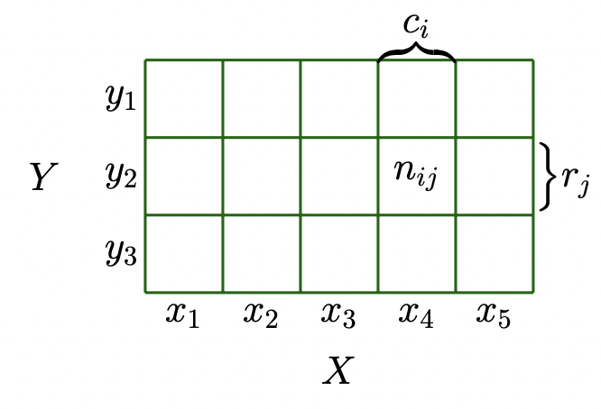








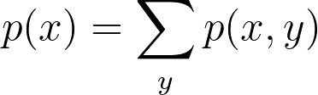

Discrete Probabilities
When target space is discrete (i.e., integer)
We define “Probability mass function” (p.m.f) of a discrete probability distribution.
For two random variables and , where denote the number of events for states and , where denote the total number of events.
This joint probability is often written as for and .
The marginal probability:
The conditional probability of y given x :

Slide 6


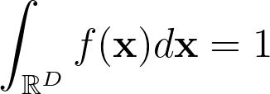
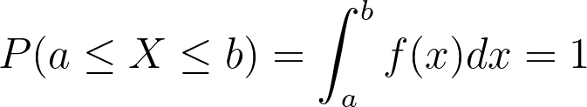


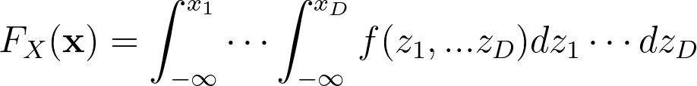
Continuous Probabilities
A function is called a probability density function (pdf) if
,
A cumulative distribution function (c.d.f) of a multivariate real-valued random variable with states is:

Slide 7
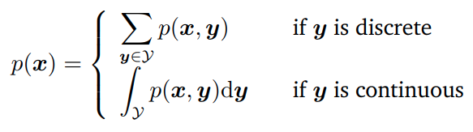

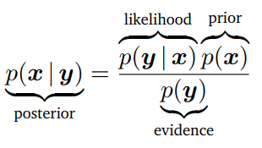
Rules of Probability
Sum rule :
Product Rule :
Baye’s Rule :
: making an inference of unobserved (latent) random variable ,
from observed values of .

Slide 8


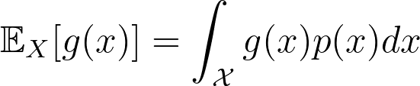
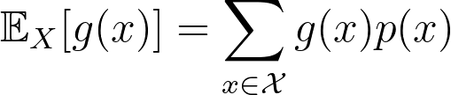
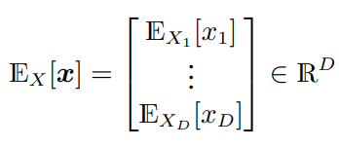
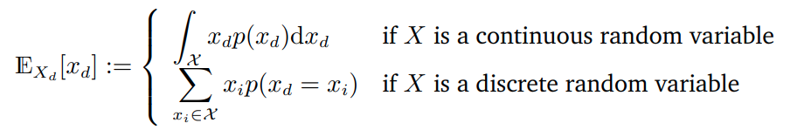
Means
The expected value of a function of a univariate continuous random variable is given by:
, and for discrete random variable, .
This a linear operator.
The mean of a random variable with states is defined as:
, where
Modes : most frequent value.
Median : the middle value.

Slide 9


Covariance
For univariate random variables, , the covariance between two is given as the expected product of their deviations from their respective means:
⇒
⇒ The covariance of itself is called as variance, and its root is standard deviation.
⇒ By using the linearity of expectations, .

Slide 10


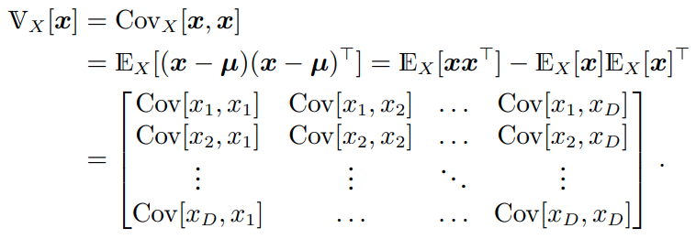
Covariance
For multivariate random variables, where , , covariance is a matrix as:
⇒
⇒ The covariance of itself is also called a variance, as below.
A symmetric and positive-semidefinite
Covariance matrix.

Slide 11

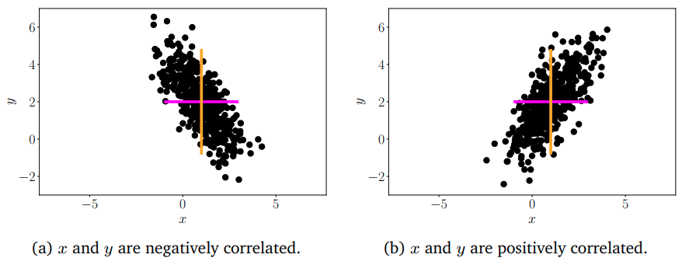
Correlation
The correlation between two random variables is given by
⇒
⇒ Indicates how two random variables are related.

Slide 12



Empirical Mean and Covariance
Given a finite dataset of size N, we can obtain an estimate of the mean.
The empirical mean / sample mean vector is the arithmetic average observations for each variable, defined as . where are observations.
The empirical covariance matrix is .

Slide 13

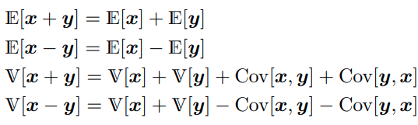


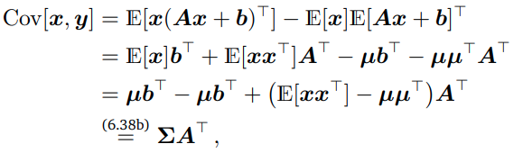
Sums and Transformations of Random Variables
For two random variables with states ,
What would happen for ?
⇒

Slide 14

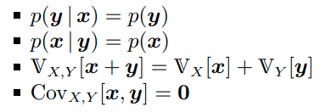




Independence
Two random variables are independent if and only if , and below properties are hold:
Two random variables are conditionally independent given if and only if:
Here, what would imply?

Slide 15





Bernoulli distribution
For a single binary random variable with state (i.e., coin flip) assume that we observe with probability .
We write this as , and
How we get mean and variance?
⇒
Notes:
dropout

Slide 16
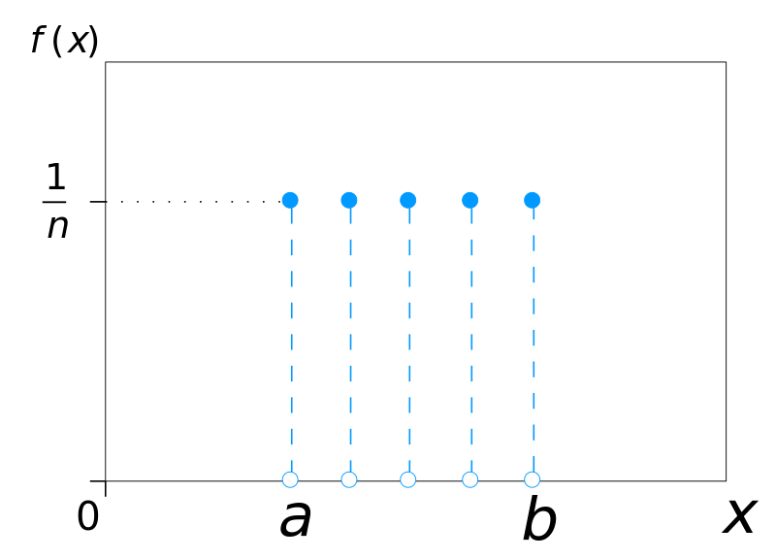
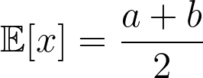
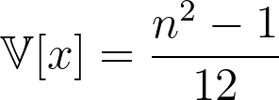
Uniform Distribution
When every possible values is equally likely.
For discrete random variable with states , its p.m.f is :
, .

Slide 17

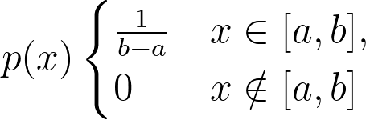
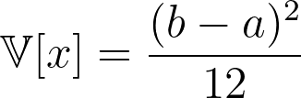
Uniform Distribution
When every possible values is equally likely.
For continuous random variable with states , its p.d.f is :
,
⇒

Slide 18


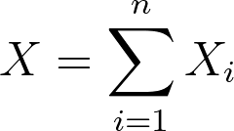


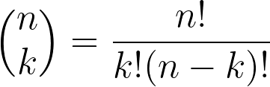
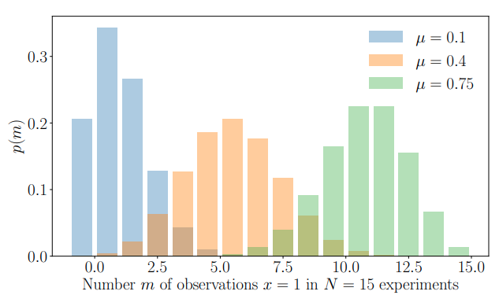


Binomial Distribution
Performing a sequence of independent experiments, where the probability of each success is .
Each experiment is an independent random variable , which encode success with 1, failure with 0, such that .
Then, if , we write and ,
where .
, .

Slide 19





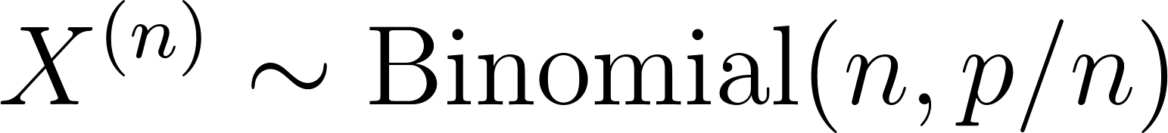

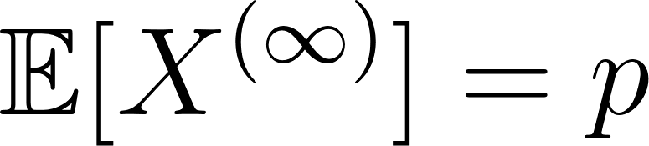
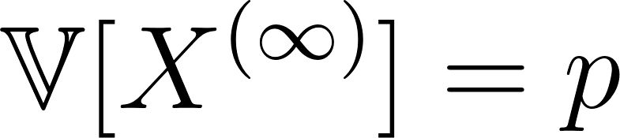
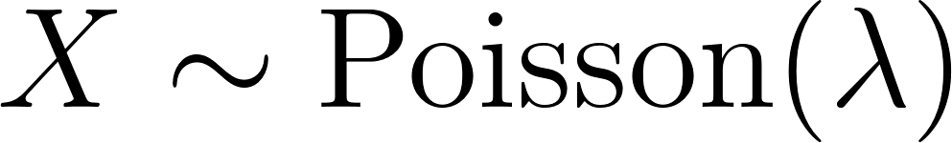
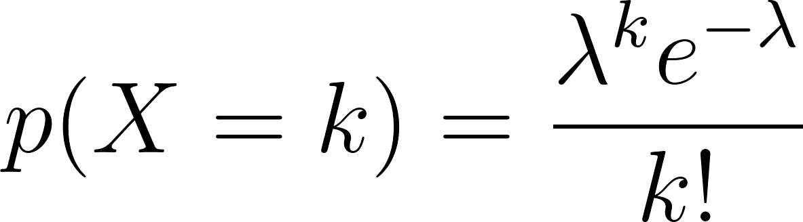

Poisson Distribution
The probability of a given number of events what can occur in a fixed interval of time/space.
Let us assume that “event” is “one bus arrives bus stop”, in a fixed “1 minute” time window.
Denote this with .
If you want to model “max. two bus arrive bus stop”, in a fixed “1 minute”, you can…
30sec 30sec
, ,
, ,
Consider , and try to . Then, and .
We say ,
if it is a random variable which takes the non-negative integer values with probability .
is a rate/shape denoting the average number of events we expect in one unit of time.

Slide 20
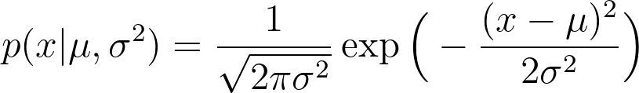



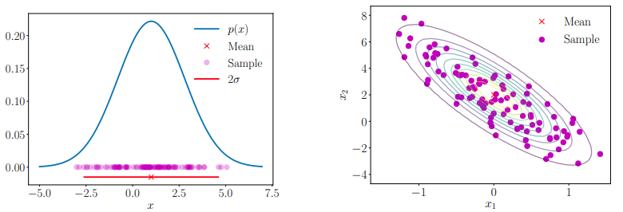
Gaussian Distribution
For univariate random variable, the Gaussian distribution has a density as:
, where is mean and is variance.
For D-dimensional random variable, the Gaussian distribution has a density as:
We write or .

Slide 21
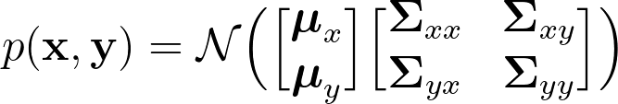



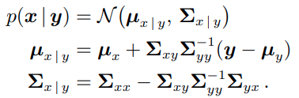

Properties of Gaussian Distribution
For two multivariate random variables and , If joint distribution is defined as:
, where .
Then, conditional distribution is also Gaussian, such that:
The marginal distribution is also Gaussian,
where , same for .

Slide 22
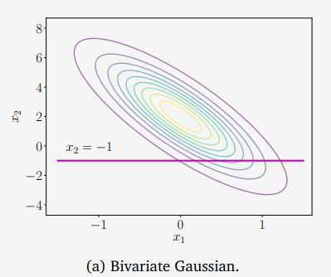
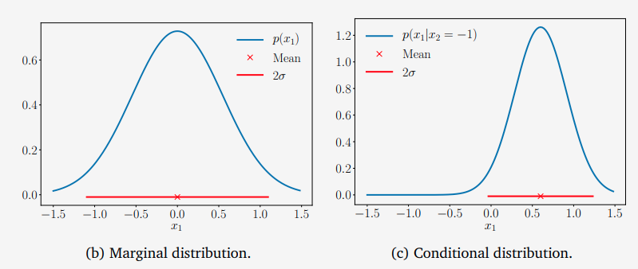
Properties of Gaussian Distribution

Slide 23

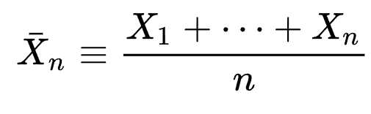


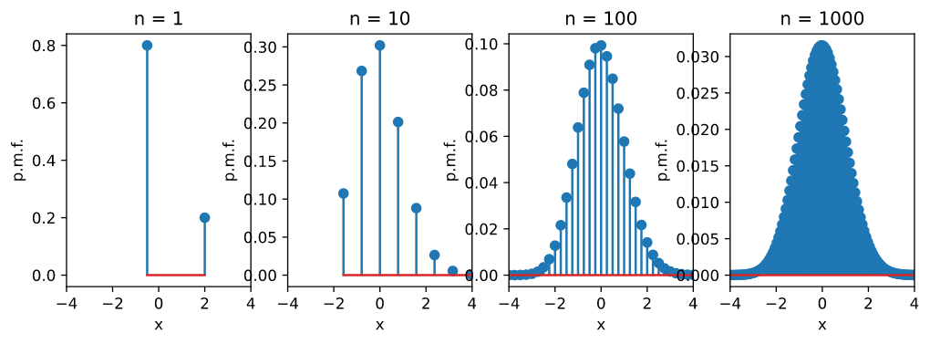
Central Limit Theorem (CLT)
Let be i.i.d (independent, identically distributed) random variables with finite mean and finite variance .
The sample average is .
By the law of large numbers, the sample average converge almost surely to as .
Central Limit Theorem:
For large enough , the distribution of gets arbitrarily close to the Gaussian distribution with mean and variance .

Slide 24
Any Questions?

